Slide 1
Errors
CSC 301: Jesse Hockenbury

Slide 2
Administrative
Cincinnati Financial job fair is TOMORROW, seats on the bus are still available
Continue working on your final projects

Slide 3
What is an Error
An error is a defect in a program that causes it not to function as intended.
Some programmers call defects in a program features (joke)

Slide 4
Web Application Error types
In a PHP project there are several potential areas for errors:
HTML / CSS
PHP
SQL
JavaScript

Slide 5
HTML Errors
HTML errors are those errors that either:
Cause the layout to not display properly
Do not pass data to PHP on form submission
These errors are caused and can be resolved by adjusting the markup of the HTML and CSS

Slide 6
PHP Error - Syntax
Syntax errors – occur when there is a mistake in the coding of the program. An example would be forgetting a semicolon at the end of the line. Causes program execution to halt.

Slide 7
PHP Error - Runtime
Runtime Errors – those errors that improperly attempt to run code but are syntactically are correct in structure. For example, calling a method that isn’t defined. The program will display an error, but attempt to continue.

Slide 8
PHP ERROR – Logic Error
Logic errors – Errors that do not necessarily cause the program to be broken but cause unintended results. For example, iterating over a loop one too many times or an incorrect math formula.

Slide 9
SQL ERRORS
SQL errors are often syntactical but can be runtime or logic errors
Common Errors:
Incorrect table/column name
Improper ordering of clauses such as where, group by, order by, limit
Parameters passed not what is expected

Slide 10
CODING

Slide 11
HTML Errors
The best tool in identifying issues with HTML is to use the inspect element found within Google Chrome

Slide 12

PHP ERRORS
To ensure all PHP errors are shown for your application on ALL servers you should include the following code snippet which enables full error reporting
This snippet would be placed at the top of the config file to ensure it applies to all pages of our application

Slide 13
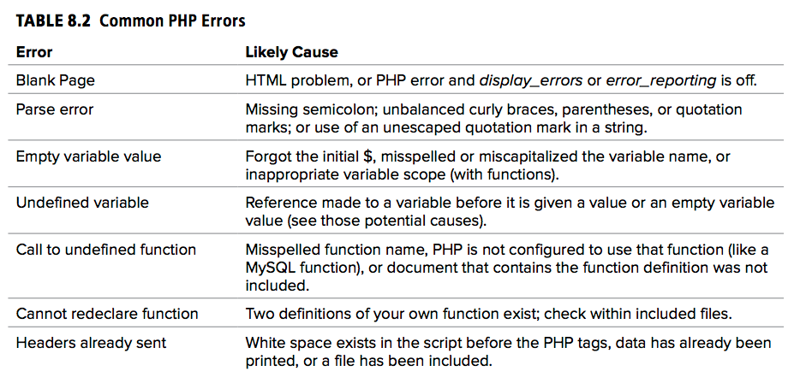

Slide 14
Printing variables to verify
One of the most valuable tools is attempting to print the value of variables to see what they hold
To echo single pieces of information the echo command will work
For arrays, you will need to use the print_r() function.
This is super useful for testing parameter array for SQL statements.

Slide 15
SQL errors
When writing an SQL query, I recommend running a sample copy of it it in MySQL Workbench to ensure the syntax is correct.
If a query works in Workbench and not in your PHP that means there is an error in the way you are calling SQL or the parameters being passed
In order to view MySQL errors that occur in PHP the application should set the error reporting level of database errors otherwise they won’t be printed
Once implemented, MySQL errors will be printed to the screen if they occur

Slide 16
Resources
https://www.w3schools.com/php/func_error_set_error_handler.asp
http://php.net/manual/en/function.get-defined-vars.php
Notes:
Printing html tagd to make reading errors easier
Echo <pre>
Print_r(variable name) ex $debug
Echo </pre>’;

